Slide 1
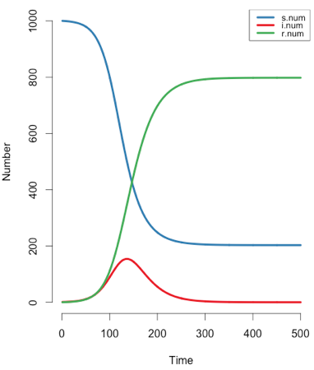
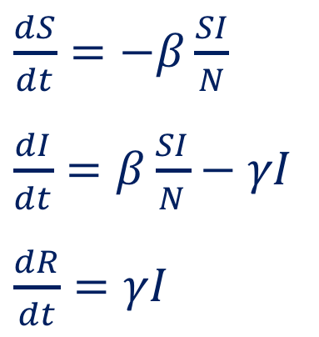
How to Predict a Pandemic
Rachel Oidtman
Ann Raiho
$\frac{dS}{dt}=−β\frac{SI}{N}$
$\frac{dI}{dt}=β\frac{SI}{N}−γI$
$\frac{dR}{dt}=γI$
EpiModel v1.2.4

Slide 2
What is a disease?
Noninfectious diseases
An illness caused by genetics, environmental factors, or deficiencies in nutrition that does NOT spread through a population

Slide 3
What is a disease?
Noninfectious diseases
An illness caused by genetics, environmental factors, or deficiencies in nutrition that does NOT spread through a population
Infectious diseases
An illness caused by a communicable (AKA contagious) pathogen that spreads through a population

Slide 4
What drives disease outbreaks and pandemics?
Human movement
Artwork from WHO Managing epidemics: key facts about major deadly diseases

Slide 5
What drives disease outbreaks and pandemics?
Human movement
Climate change
Artwork from WHO Managing epidemics: key facts about major deadly diseases

Slide 6
What drives disease outbreaks and pandemics?
Human movement
Climate change
Increased human contact
Artwork from WHO Managing epidemics: key facts about major deadly diseases

Slide 7
What drives disease outbreaks and pandemics?
Human movement
Climate change
Increased human contact
Urbanization and habitat fragmentation
Artwork from WHO Managing epidemics: key facts about major deadly diseases

Slide 8
What drives disease outbreaks and pandemics?
Human movement
Climate change
Increased human contact
Spillover from animals
Urbanization and habitat fragmentation
Artwork from WHO Managing epidemics: key facts about major deadly diseases

Slide 9
Artwork from WHO Managing epidemics: key facts about major deadly diseases
Notes:
Population biology is the study of the factors determining the size and distribution of a population, as well as the ways in which populations change over time. Population Biology - Dictionary definition of Population Biology | Encyclopedia.com: FREE online dictionary

Slide 10
Epidemic! The Handshake Game
This game will help demonstrate how epidemiologists utilize mathematics to describe the spread of a pathogen.
Game credit: NIMBIOS
http://ec2-23-21-117-9.compute-1.amazonaws.com/blogs/09/07/2011/epidemic-the-handshake-game.html

Slide 11
Susceptible-Infected-Recovered Model

Slide 12
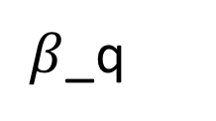
Susceptible-Infected-Recovered-Quarantined-Vaccinated Model
$β$_q
Vaccination

Slide 13
Discussion
What was the best choice, vaccination or quarantine?
What would happen if everyone chose to be vaccinated?
Was quarantining effective? Is it always possible to quarantine?

Slide 14
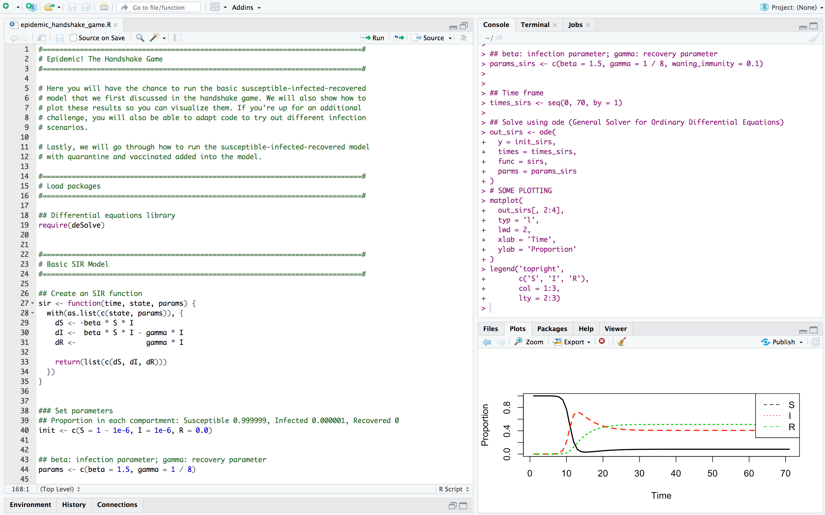
https://www.r-project.org/
To run code, highlight and press command-return
Script
Console
1) Open R app
2) Open file called ‘epidemic_handshake_game.R’ from R app
https://github.com/araiho/epidemic_STEM_workshop/blob/master/epidemic_handshake_game.R

Slide 15
SIR Results

Slide 16
SIRS Results

Slide 17


Our contact information
Dr. Ann Raiho
Postdoctoral Researcher, CSU
ann.raiho@gmail.com
Rachel Oidtman
PhD Candidate, Notre Dame
roidtman@nd.edu

